Slide 1
CSS for interactions
WEBD 113 - Motion Graphics
Link to slides: http://bit.ly/humber-motion-3
Ryan Christiani
Week 3

Slide 2
Review
CSS Selectors - 3 types.
Property vs Value

Slide 3
CSS Selectors
p {}
/* Descendent selector */
div p {}
/* Child selector, selects only child elements */
div > p {}
/* Adjacent Selector */
div + div {}
/* Attribute Selector */
input[type=”text”] {}

Slide 4
The “Cascading” portion of CSS
p {
color: blue;
color: red;
}
CSS reads top to bottom. The bit of CSS would first colour the text blue, but it would then be overridden by the next rule and colour it red.

Slide 5
:hover
a {
color: red;
}
a:hover {
color: blue;
}
https://developer.mozilla.org/en-US/docs/Web/CSS/:hover

Slide 6
:hover cont.
The :hover pseudo-class is used as a way to show an interaction.
It works by taking a starting state and changing that state on hover.
Note that :hover does NOT work on mobile, it is near impossible to get figure out when you are hovering over a screen.

Slide 7
Transitions
.box {
height: 300px;
width: 300px;
background-color: red;
transition: all 0.5s ease;
}
.box:hover {
border-radius: 50%;
}

Slide 8
Transition cont.
The transition property is used to transition between two states. The initial state and the final state.There are two ways to write a transition:
First (Shorthand):
transition: all 0.5s ease;
Second:
transition-property: all;
transition-duration: 0.5s;
transition-timing-function: ease;

Slide 9
Transition cont.
Transitions are typically handled with :hover/:active or dynamically with javascript. With Javascript might end up adding a class to an element in which that new class has to final state and the initial class has the first state.
.box {
…
}
.box.round {
border-radius: 50%; /* makes it a circle */
}

Slide 10
Transition values
Property: What do you want to transition, all is a catch all. You can also define a specific property. Ex: opacity, height, width, background-color…
Duration: A value defined in in seconds. 0.5s is half a second, or 500 milliseconds. Adding the s is very important, otherwise the browser will just think it is a regular number.
Timing Function: A timing function is like a curve. It is defined with a bezier curve, or a predefined named function.

Slide 11
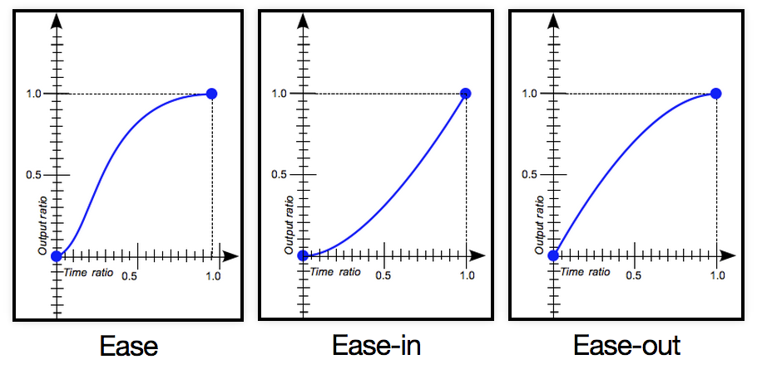
Timing functions types:
linear
ease
ease-in
ease-in-out
ease-out
step-start
step-end
https://developer.mozilla.org/en-US/docs/Web/CSS/transition-timing-function

Slide 12
Try it out yourself.
Create a simple page and add some elements. You can used a div element for ease.
Try out transitioning a few properties using the :hover pseudo-class property and play around with the different timing functions
https://developer.mozilla.org/en-US/docs/Web/CSS/CSS_animated_properties

Slide 13
Transforms
The CSS transform property lets you modify the coordinate space of the CSS visual formatting model.
Using it, elements can be translated, rotated, scaled, and skewed according to the values set.

Slide 14
Transforms cont.
Here is a small list of 2D transforms. This is not an exhaustive list.
translate()
rotate()
scale()
skewX()
skewY()
https://developer.mozilla.org/en-US/docs/Web/CSS/transform

Slide 15
Transform Examples
transform: rotate(90deg);
transform: scale(1.5);
transform: translateY(500px);
transform: skewX(10deg);

Slide 16
Transform Examples cont.
.box {
height: 300px;
width: 300px;
}
.box:hover {
transform: rotate(45deg);
}
.box:hover {
transform: rotate(45deg) scale(1.2);
}

Slide 17
Transform Examples cont.
If you are using a transform as an interaction you will typically use the transition property with it.
Transforming an element will just make it go from point A to point B instantly. Using the transition property you can control the way in which it transforms.

Slide 18
Transform Examples cont.
.box {
height: 300px;
width: 300px;
transition: all 0.5s ease;
}
.box:hover {
transform: rotate(45deg);
}

Slide 19
Transform Values
Transforms have many different values that are accepted, each is different based on the transform function you are using.
percents, angles, numbers and lengths are the most common.
Use this resource to determine what you need to use if you are unsure.
https://developer.mozilla.org/en-US/docs/Web/CSS/transform

Slide 20
The Vendor Prefix
Because most of these CSS3 properties are so new, they have been implemented differently on a browser to browser basis.
IE might(or more likely WILL) implement something different then Chrome, the name of properties might end up changing.
When something is so new it is difficult to get all the parties to agree upon an implementation.

Slide 21
The Vendor Prefix cont.
Enter the vendor prefix.
Example:
-webkit-transition: …;
-moz-transition: …;
-o-transition: …;
transition: …;

Slide 22
When do you need to use a vendor prefix?
Knowing when to use a vendor prefix comes down to knowing what browser you will have to support.
http://caniuse.com/
Can I Use is a great resource for determining when you need to add a prefix.

Slide 23
CSS Margins
We will go more indepth into the CSS Box model.
But for the purpose of our assignment for now, we can use the margin property to push your elements away from each other.
div {
margin: 15px; /*put a 15px margin all around element */
}

Slide 24
Assignment
Simple.
Transform 6 elements (you can simply use a div) and play around with various transformation and transitions on them.
I am just looking for some exploration and experimentation. You will only need to make this work in Chrome, so in most cases a vendor prefix will not be needed.
http://tympanus.net/codrops/ Nice resource

Slide 25
Done.

